Slide 1

Scoring Application
By TeamRoos
Sree Rama Raju Pericharla
Swetha Chandra Karroti
Pallavi Ramineni
Tejaswi Ganne

Slide 2

Introduction
Scoring Application is for ease access of judges and the organizers of the Hackathon event.
Scores update for the teams
Easy and Efficient way of result declaration

Slide 3


Architecture Diagram
server
MongoDB
Request to db
Tools & Technologies used:
Angular JS,Jqeury
MongoDB
HTML, CSS
Bootstrap
Response from db
Query
Result
Web Application

Slide 4
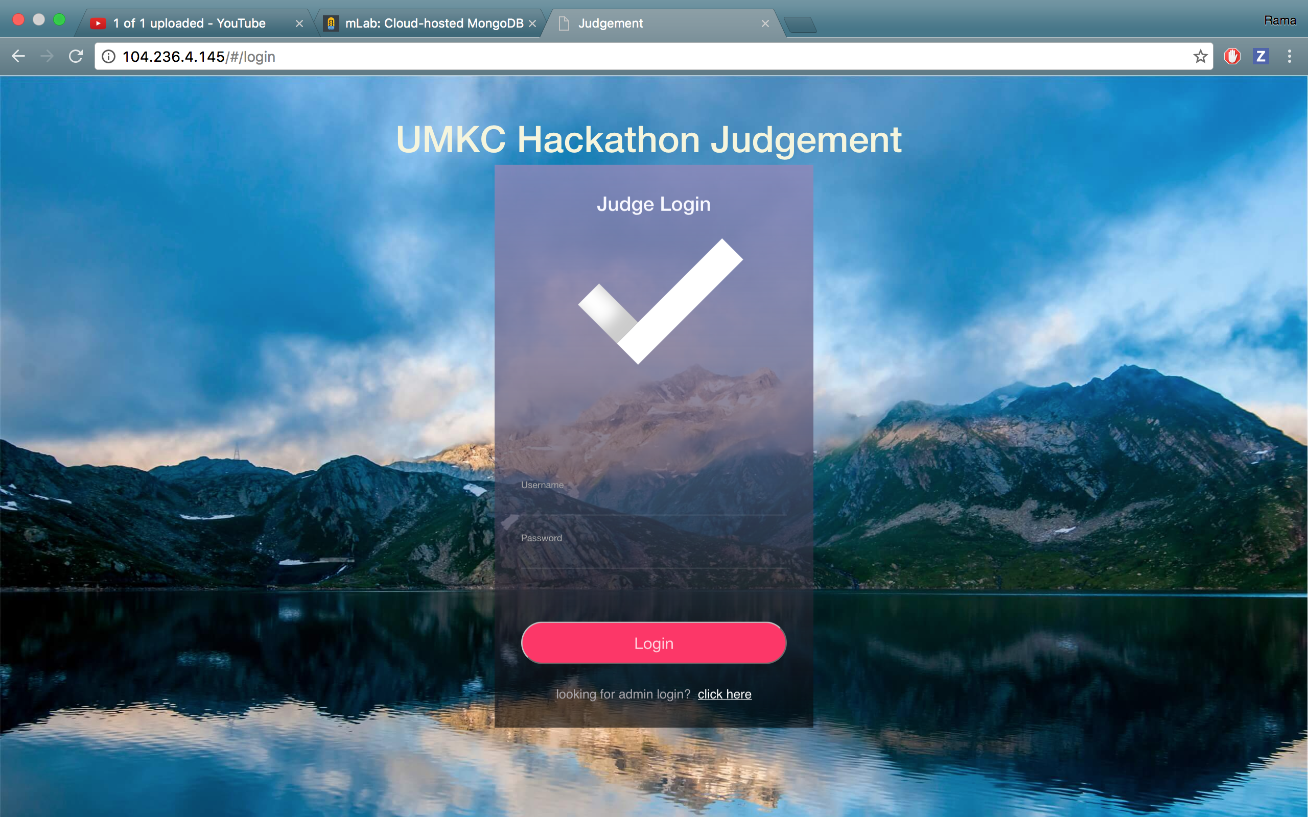
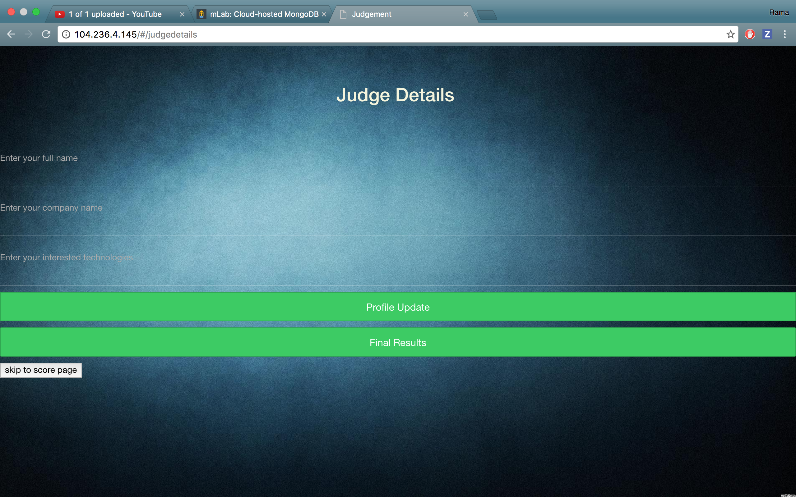
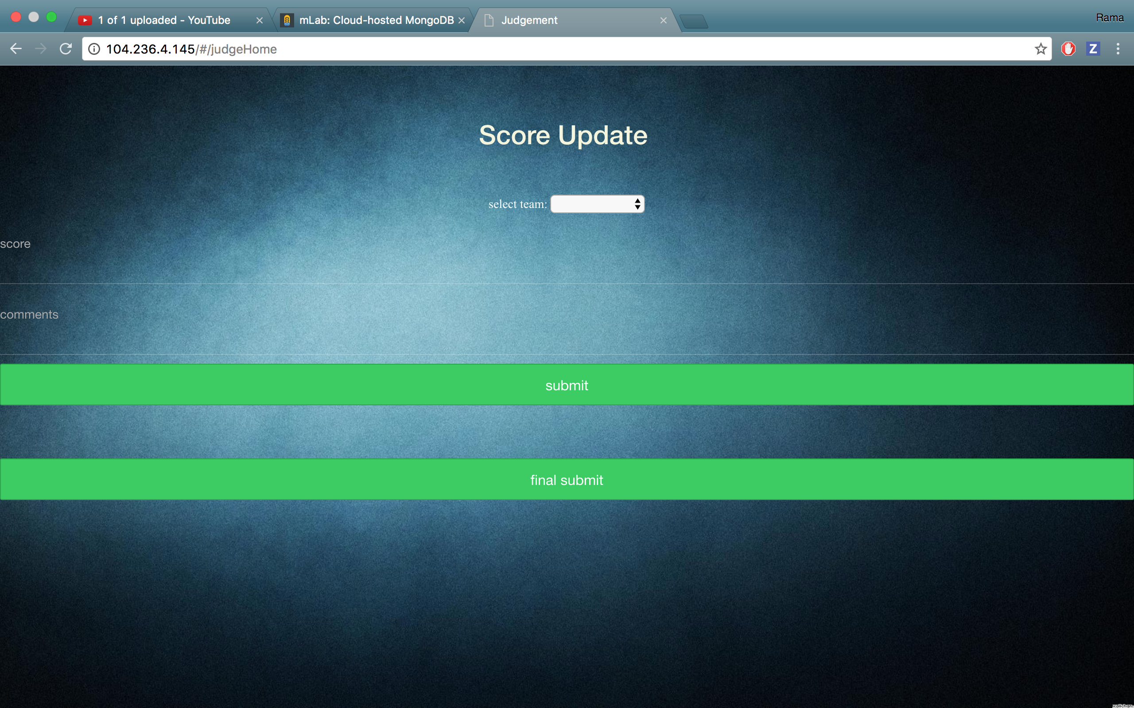
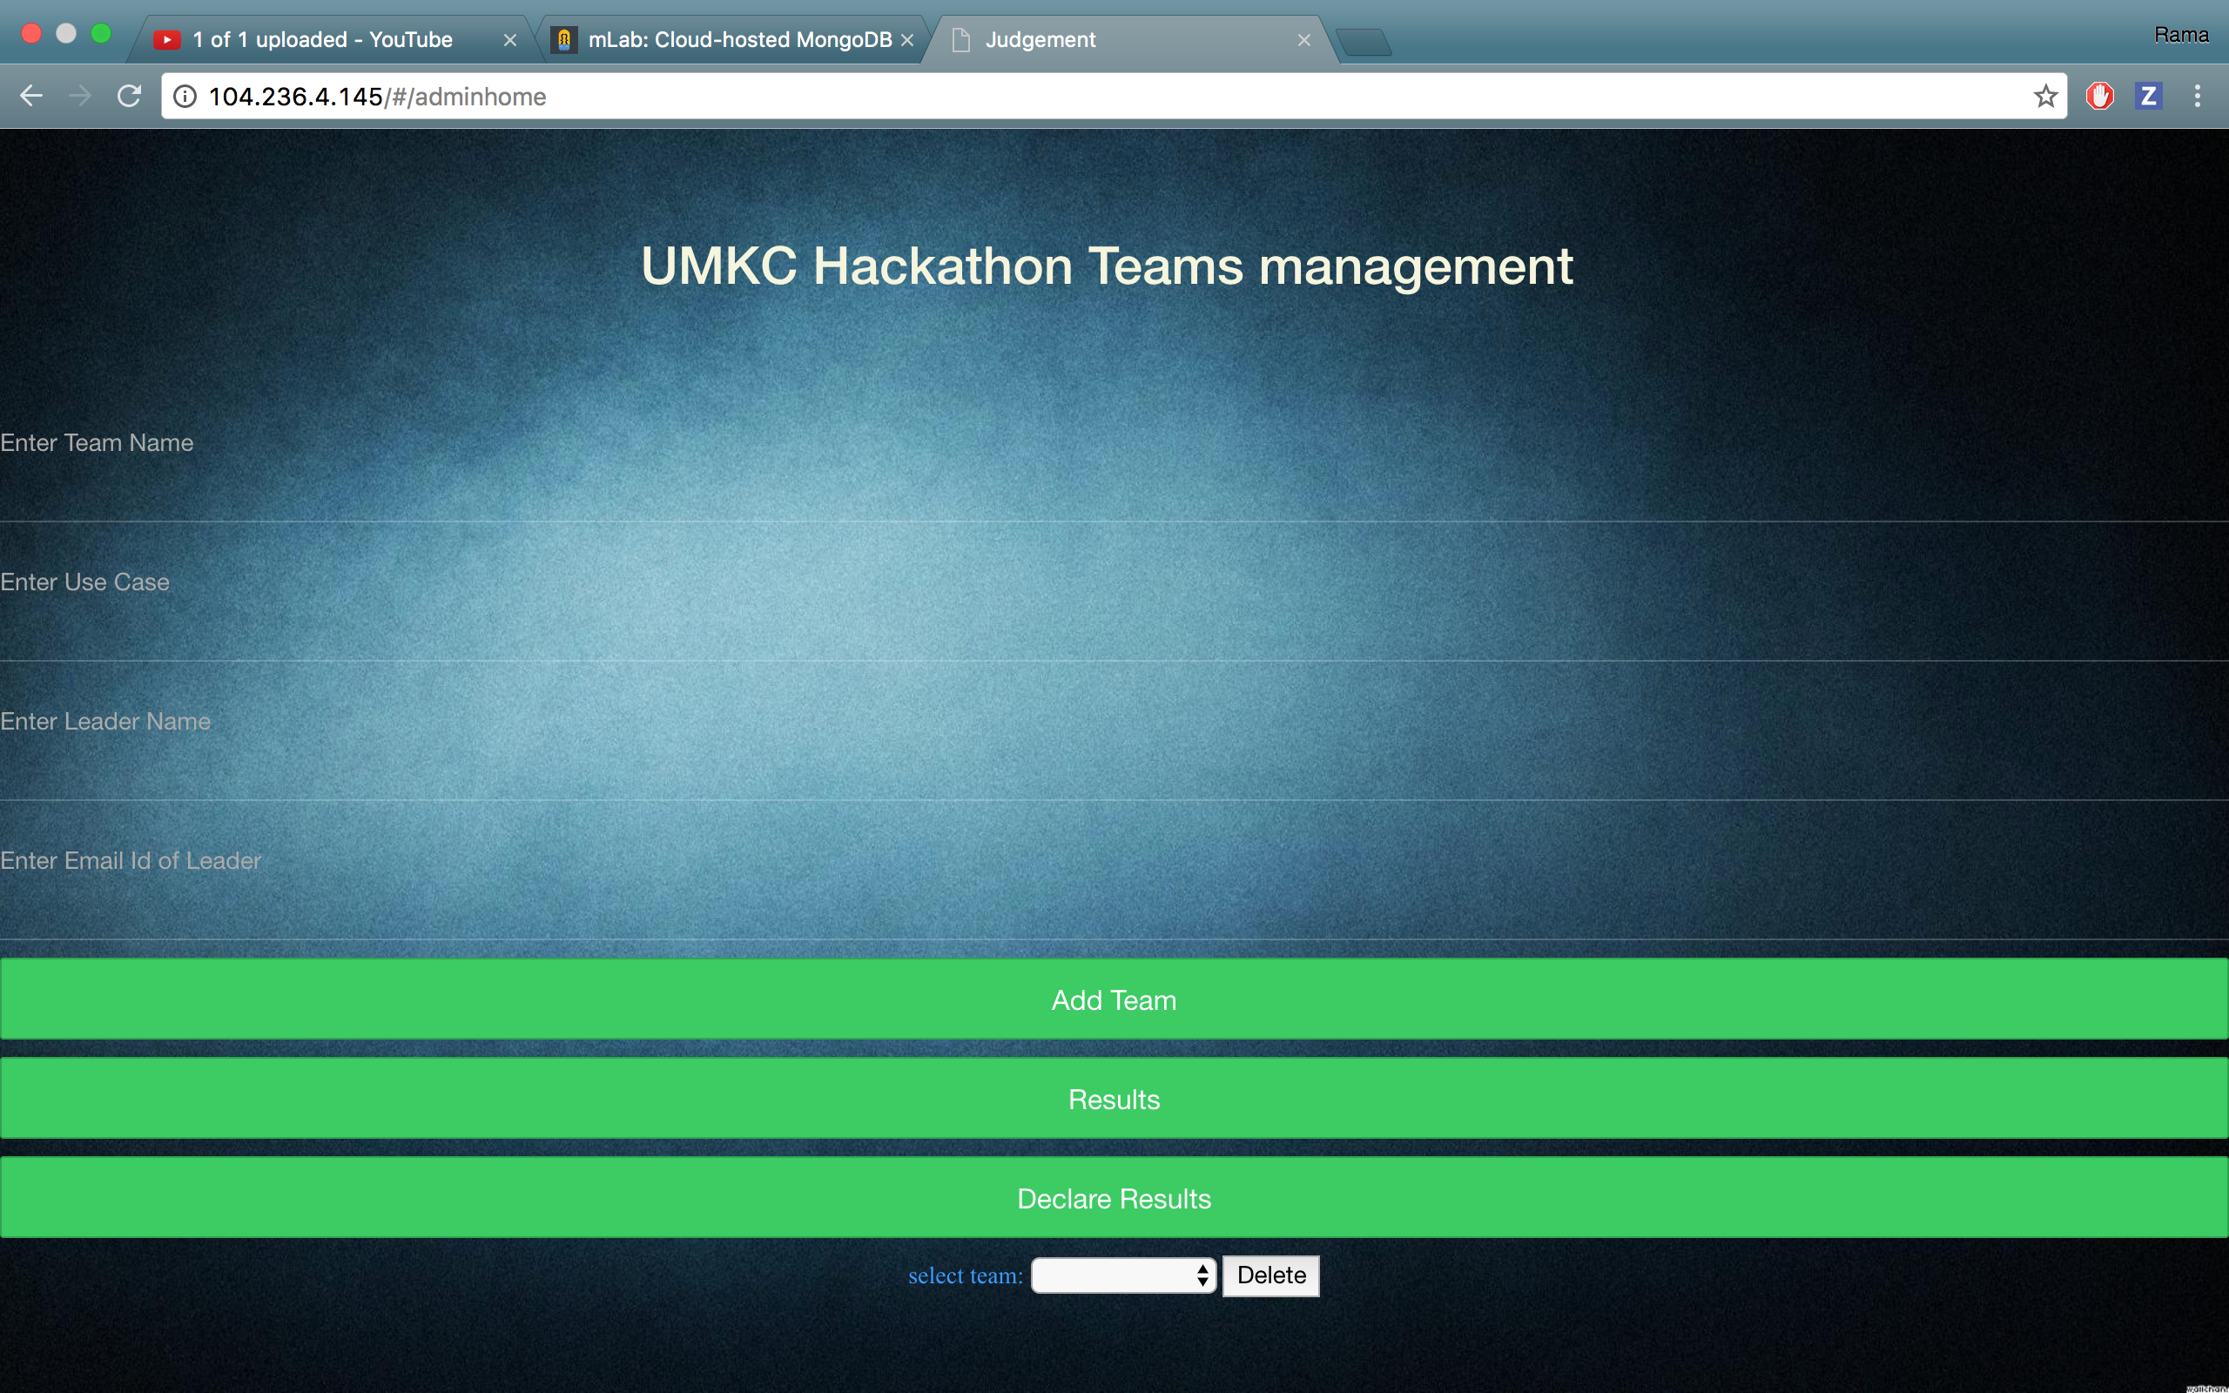
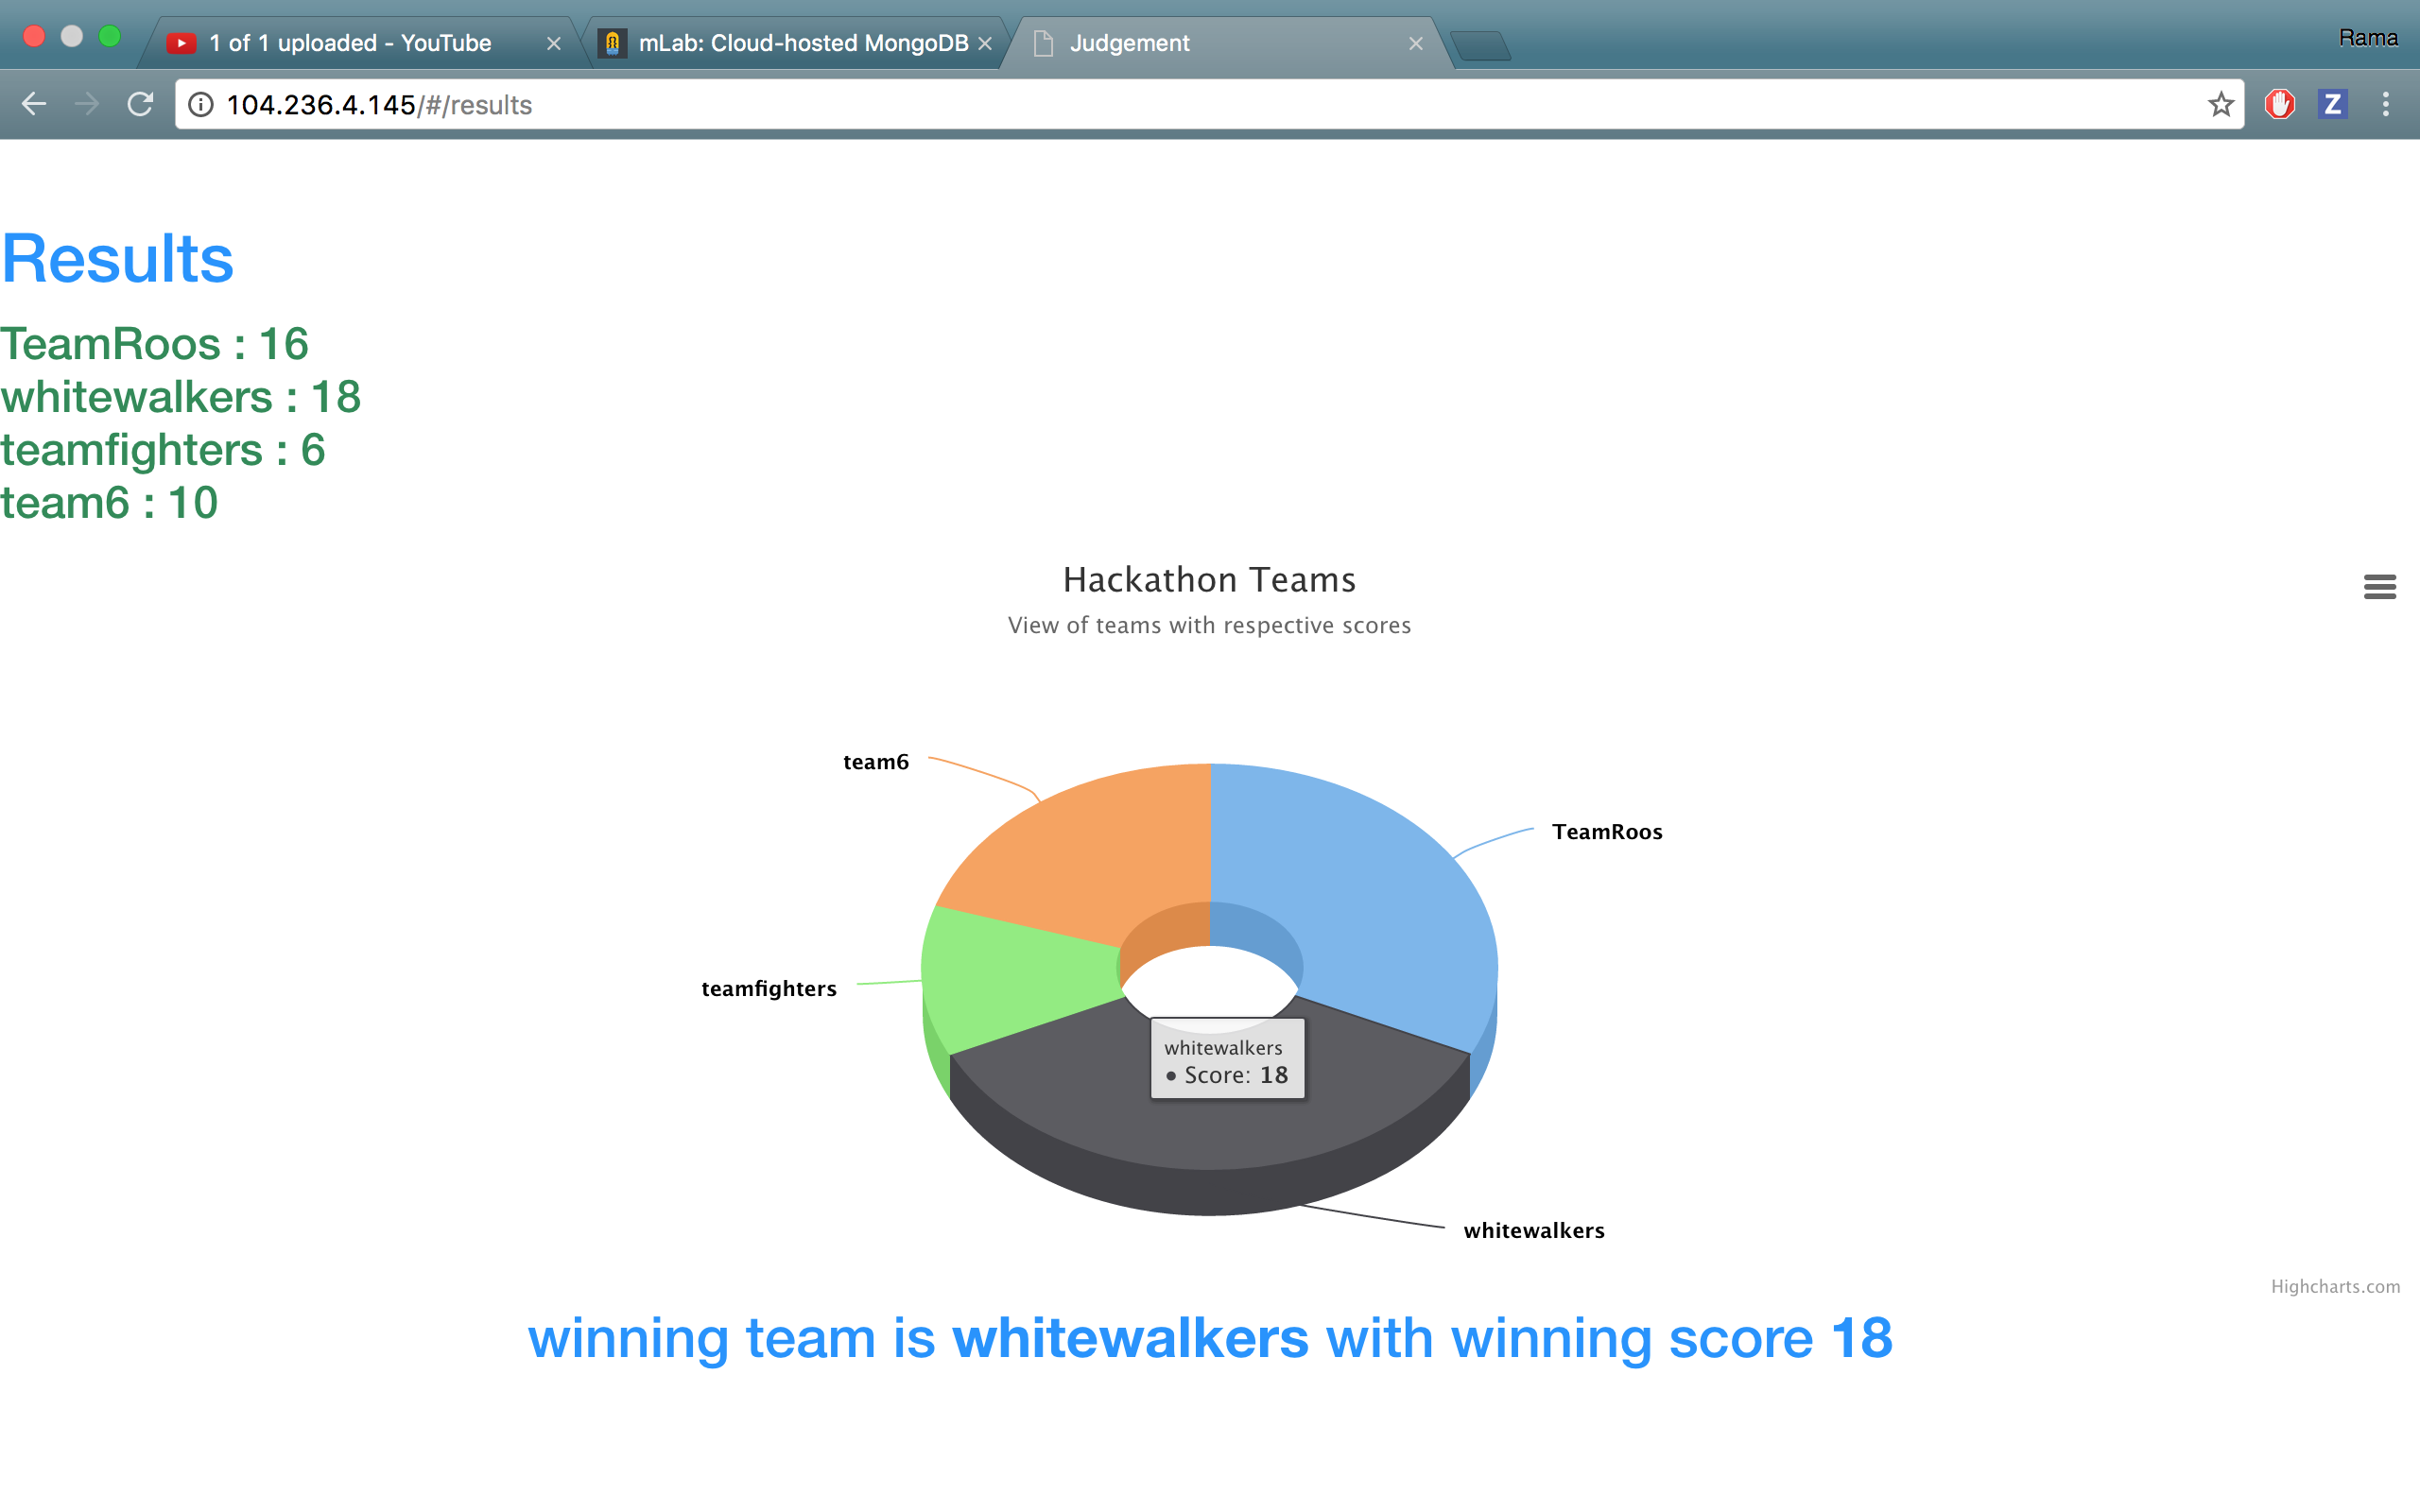
How it Works
Global URL: http://104.236.4.145/
Judge-> username:judge1,password:ram
Admin->username:ram,password:ram

Slide 5


